Slide 1
OpenStack Queens
February 2018
Marketing Community Preview

Slide 2
Agenda
New Features
Q&A
Queens features you’ll want to know about
Hold questions until the end
New Projects
New for the Queens cycle
Community Updates
Vancouver and Berlin Summits

Slide 3
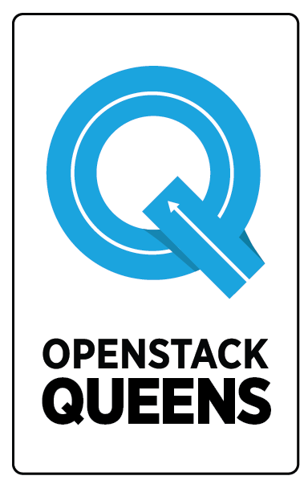
OpenStack Queens
The 17th release of OpenStack

Slide 4
Still fighting for the user
But the user’s needs have evolved…

Slide 5
Container Management
NFV
Edge Computing
HPC
Enterprise Workload Support

Slide 6
Queens:
Taking care of operators.
Supporting emerging use cases.

Slide 7
Queens Feature
Use case
User experience

Slide 8
Support for vGPUs
Enhanced power for compute-intensive apps
HPC
AI
Machine Learning
Scalability
Notes:
vGPUs, virtual graphics processing units, are incredibly powerful for certain types of high-performance workloads. Given the name, you do see them in graphics-intensive workloads, but you also see them used in a lot of scientific workloads, machine learning, AI, who need the scalable compute power that GPUs provide.
Nova has added vGPU support, so cloud admins can define flavors that request vGPU resources and specify resolutions for vGPUs, and end users will be able to boot vms which have vGPUs.

Slide 9
Cinder Multi-Attach
One Cinder volume; multiple VMs
High Availability
Enterprise
Manageability
Resiliency
Notes:
The Cinder multi-attach feature means you can attach the same, single Cinder volume to multiple vm instances.
Volume multi-attach is one of the most highly-requested features in cloud environments. An obvious benefit is that you can have two nodes accessing the same volume, so if one goes down, the other can take over and has access to the data, which supports enterprise users who need robust environments and users who need high availability.

Slide 10
Ironic Rescue Mode
Growing bare metal use; growing operator support
Manageability
Resiliency
Notes:
The bare metal project Ironic saw notable user growth in the last user survey, so it’s great that the Ironic team has implemented Rescue Mode in the Queens release to make life easier for operators. Now with Rescue Mode, Ironic users now have a safety net if something won’t boot correctly, something’s misconfigured, they lose an SSH key, etc.

Slide 11
Kuryr CNI Daemon
Improving scalability for OpenStack + K8s users
High Availability
Containers
Scalability
Resiliency
Notes:
If you’re not familiar, Kuryr is a growing OpenStack project that bridges container networking frameworks and OpenStack networking. They focus on closing gaps between container networking and Neutron, so OpenStack users can deploy containers at scale without piecemealing networking solutions.
One example of this is the Kuryr CNI daemon that they released for Queens. Rather than waiting on the Kubernetes API for each event, the CNI daemon constantly watches for pod events.
This improves the scalability of Kubernetes for OpenStack users and supports HA use cases. This provides a secondary option for creating pods if the controller goes down, supporting those high availability users.

Slide 12
HOT Drag and Drop Interface
WYSIWYG for orchestration
Manageability
User Experience
Notes:
The Heat team has added a Horizon plugin for Heat Orchestration Templates that gives users a drag and drop interface for generating templates. Previously HOT templates were only plaintext files, so this is a very user friendly way to orchestrate resources!

Slide 13
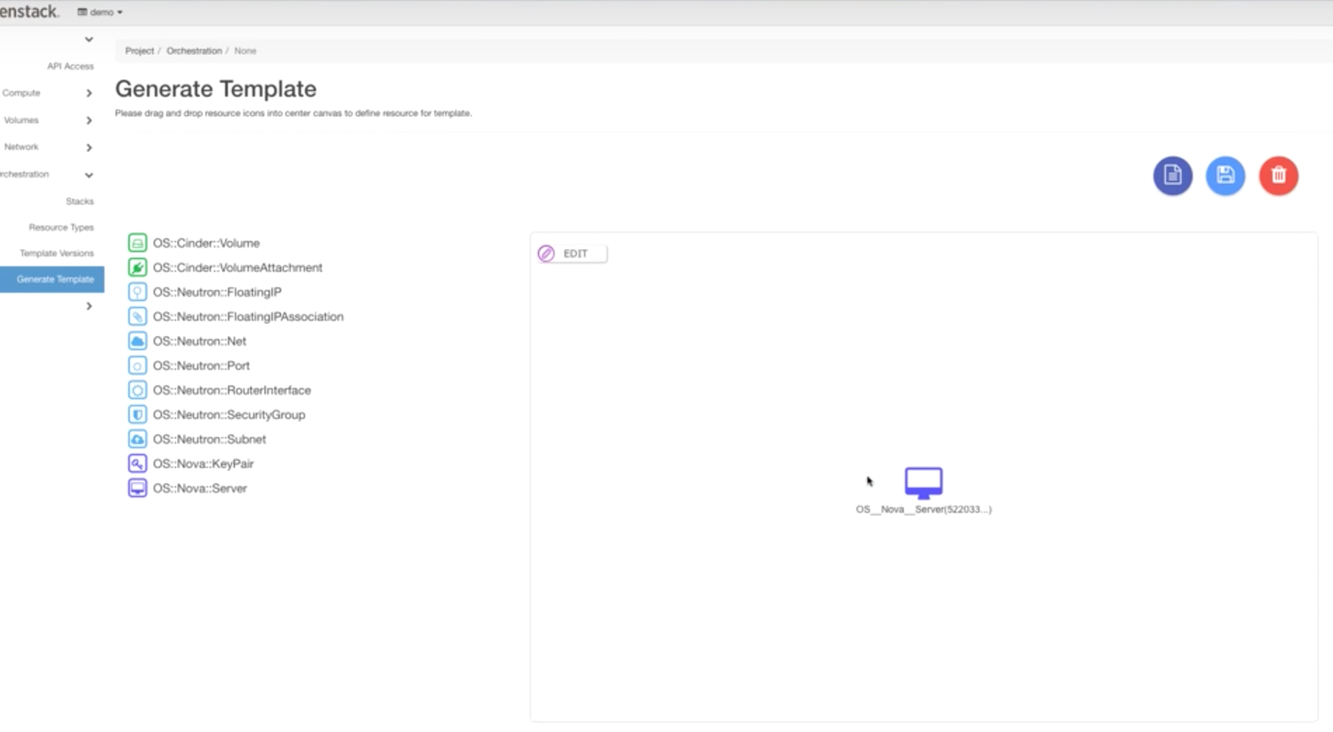

Slide 14
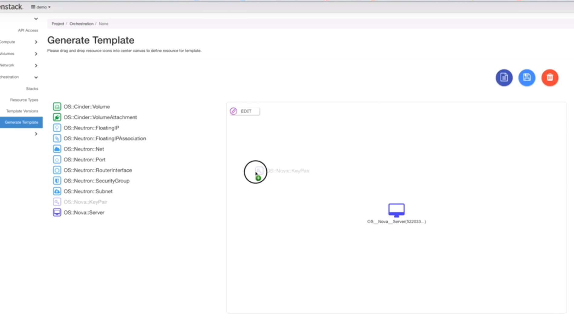

Slide 15
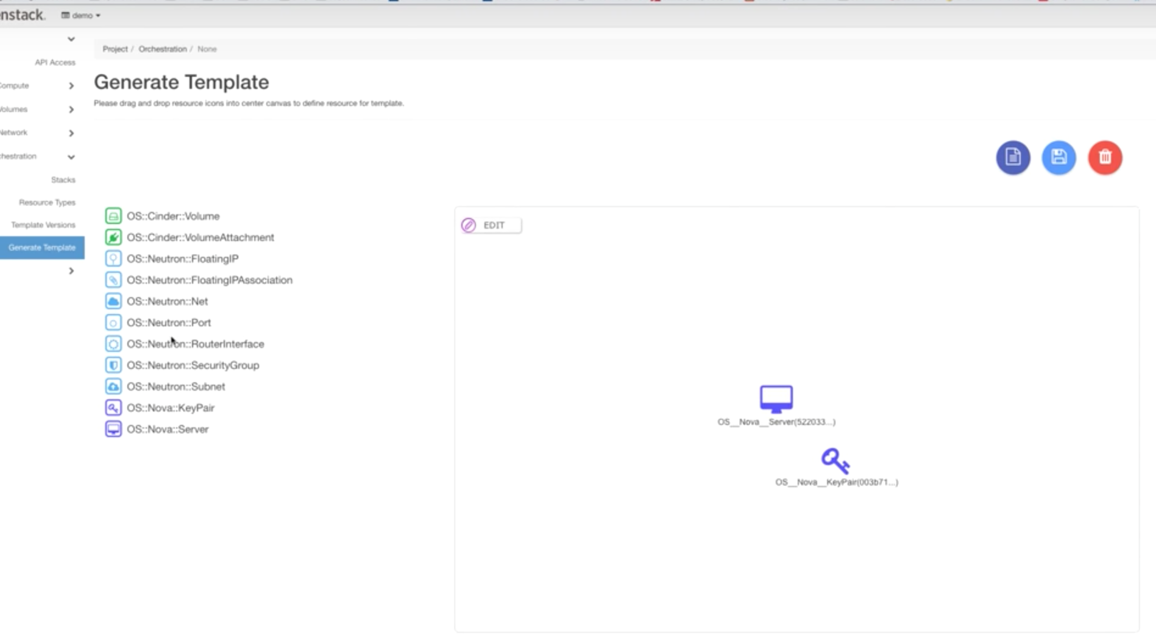

Slide 16
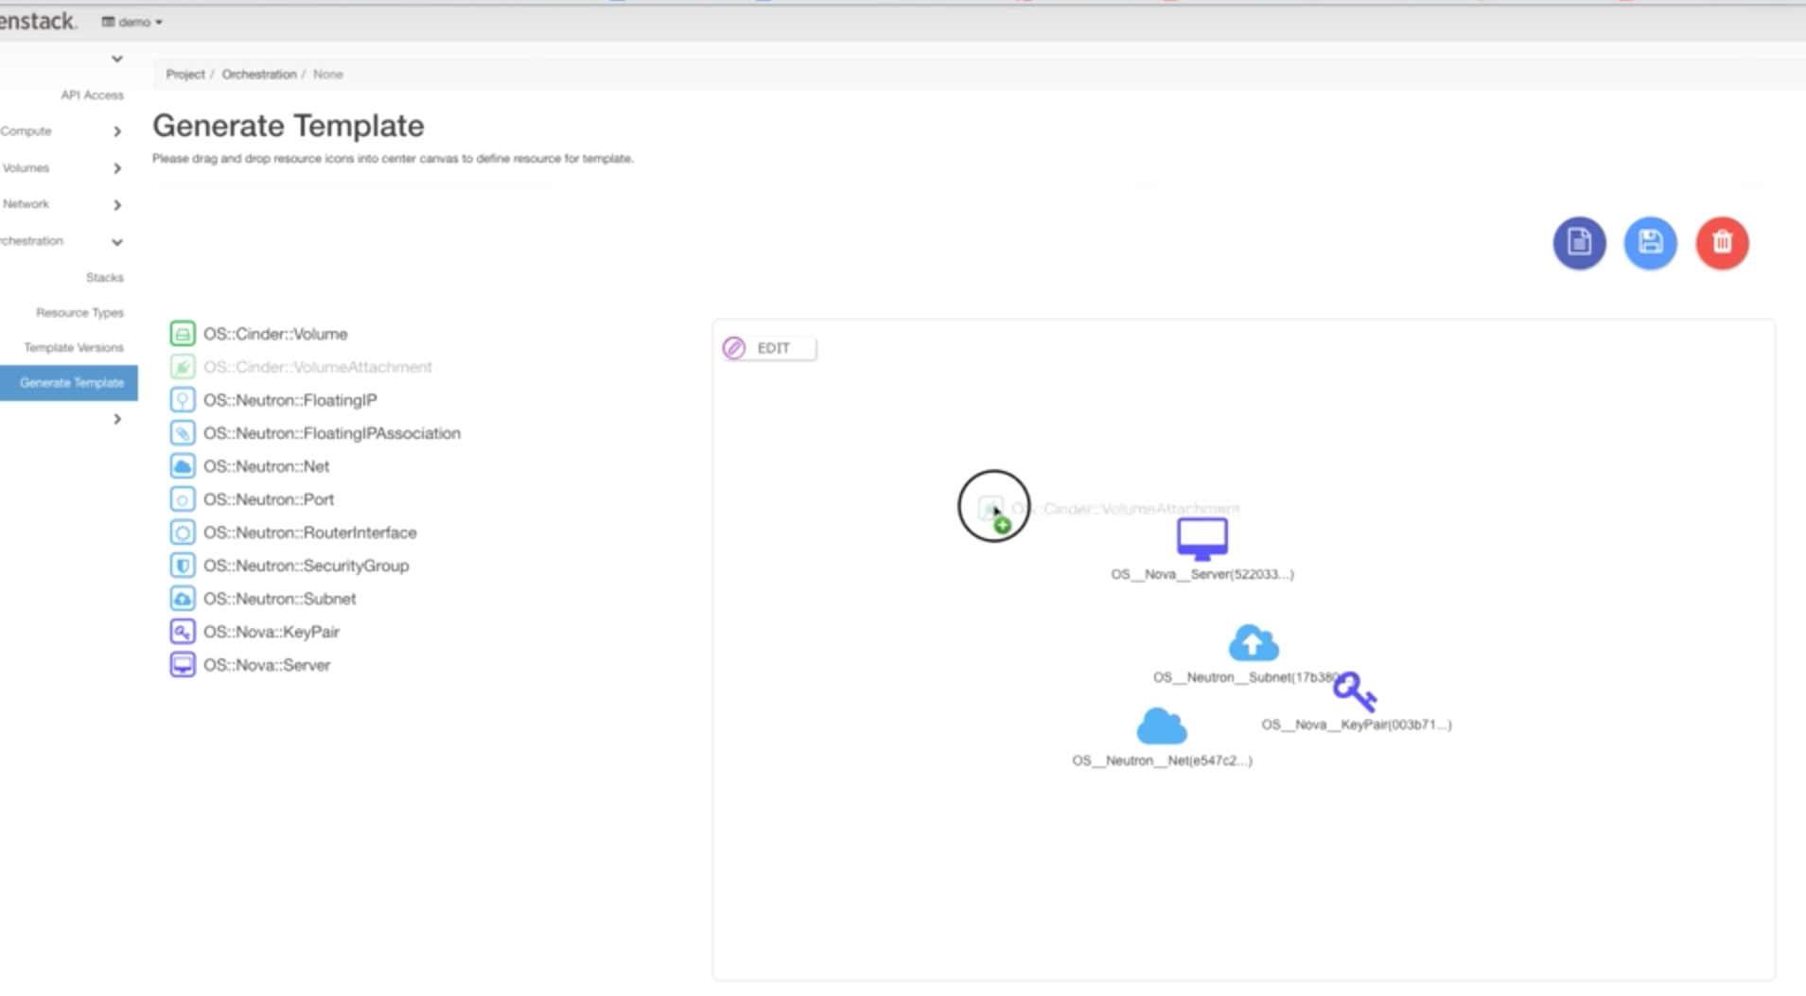

Slide 17
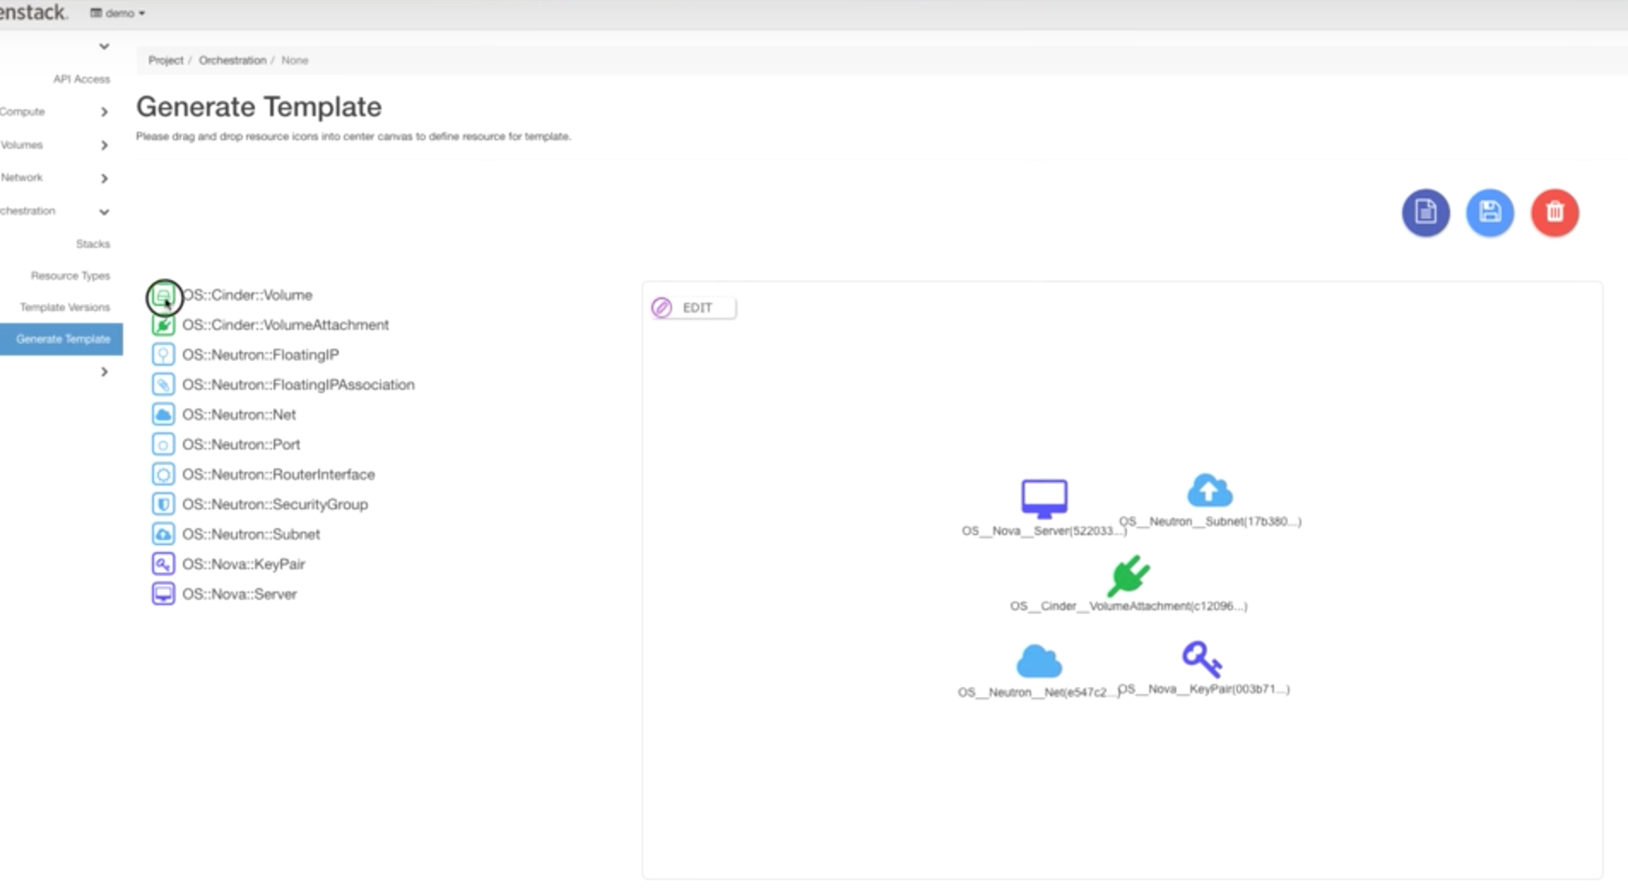

Slide 18
HOT Drag and Drop Interface
WYSIWYG for orchestration
Manageability
User Experience

Slide 19
Register and document policy in code
Improved policy communication
Manageability
Notes:
This one was a community-wide goal for the Queens release. Previously, role-based access controls—or RBAC policies—were documented in a file that lived in the project source. This meant if someone needed to read the policies or make a change, they had to go hunt for the file and dig for the policy they needed. Now in Queens, RBAC policies are now in code in the majority of projects, providing better communication about service policies and the ability to set more granular defaults in RBAC policies through that easier discoverability.

Slide 20
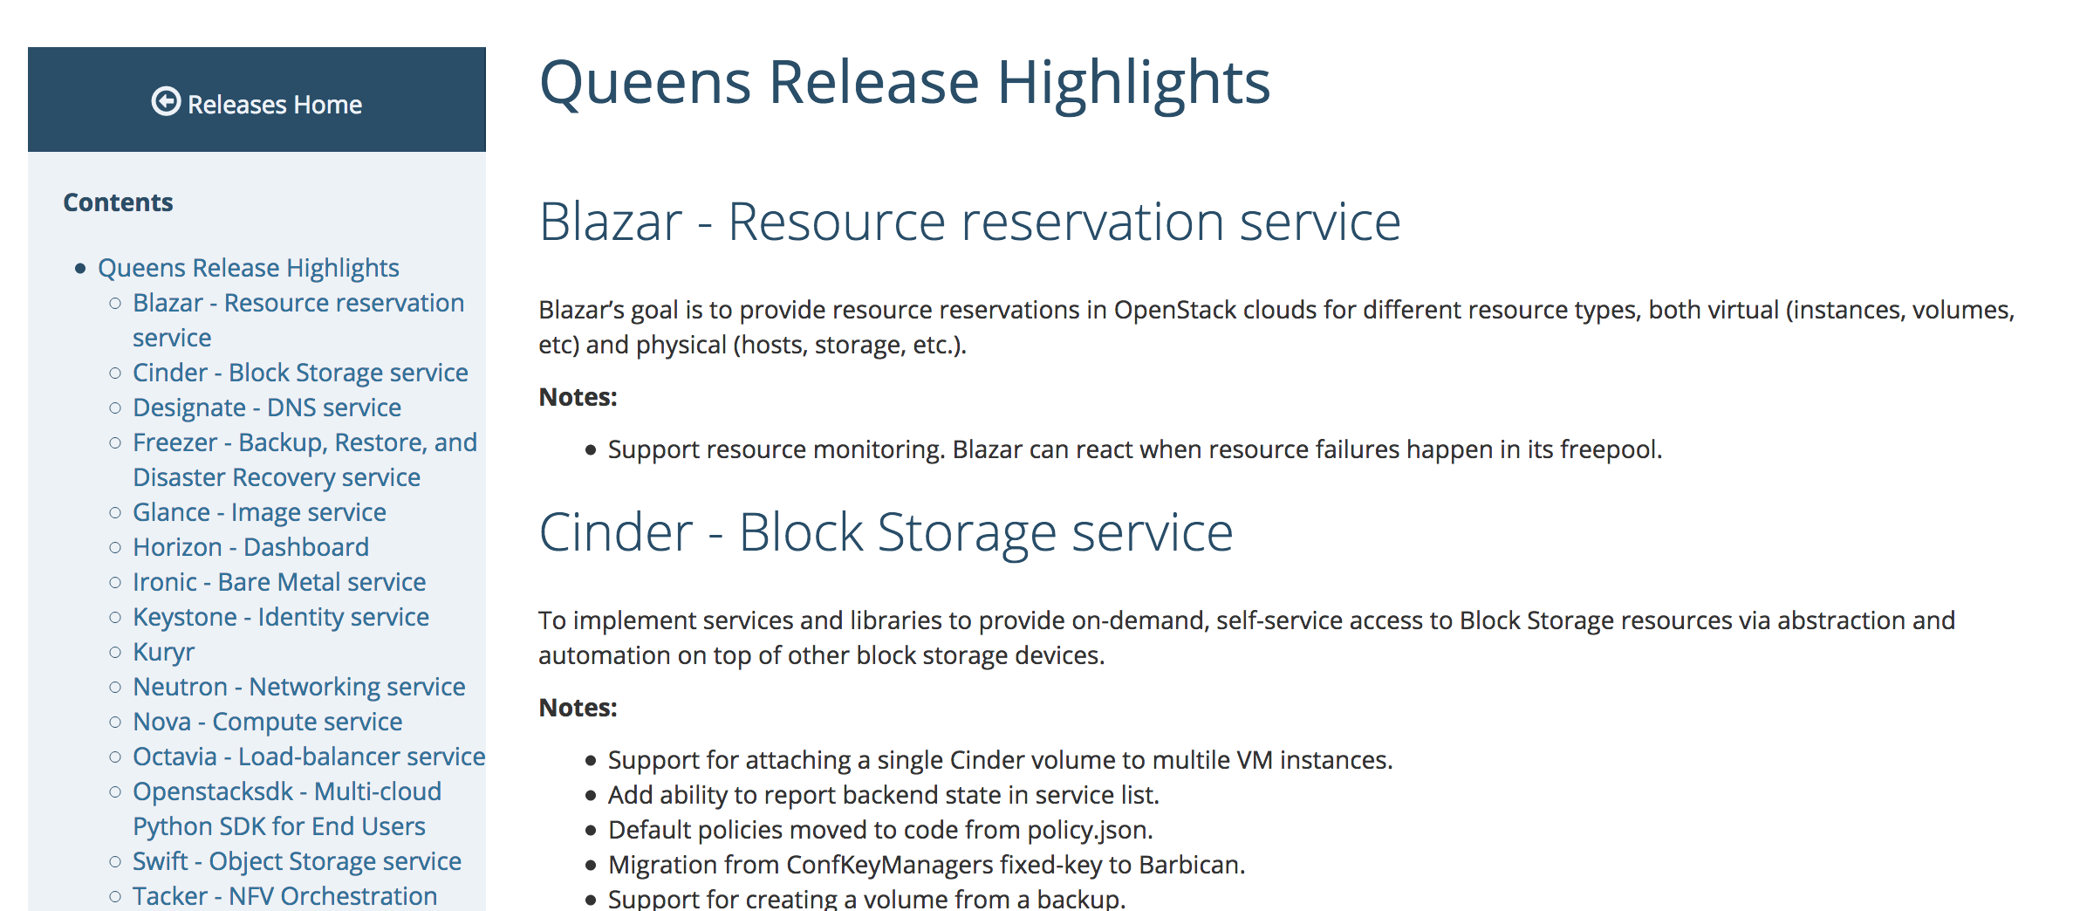
Release Highlights Page
releases.openstack.org/queens/highlights.html
Notes:
Also new for Queens is this Release Highlights page. We recognize that it can be challenging to keep up with all the features that come in every new release, and of course we can’t capture them all in this webinar. The PTLs submitted their top highlights to this page, which you can see at releases.openstack.org/queens/highlights.html. This is the first iteration and a work in progress, but this is part of a larger effort to help those who aren’t in the weeds day-to-day with project teams more information about what’s coming in each OpenStack release.

Slide 21
New Projects
New projects in the Queens cycle focus on HA and containers
Notes:
There were a handful of new projects that were added to OpenStack in the Queens cycle. In the past few cycles, we’ve talked about ending the Big Tent model and trying to get a more defined view of, “What is OpenStack?”, so adding new projects may sound contradictory on the surface. These projects though, really focus on particular areas for operational enhancements, rather than trying to tack on a completely new component or reinvent a wheel that exists outside OpenStack.

Slide 22
OpenStack-Helm
Full lifecycle management for OpenStack services atop K8s
Containers
Edge
Manageability
Notes:
Helm is a package manager for K8S that lets you define, install and upgrade applications on K8S. It uses “helm charts”, which is a collection of files that describe a related set of K8S resources. OpenStack-Helm is the collection of Helm charts and tools that let you manage the lifecycle of OpenStack services on top of K8S.
Each service has its own chart, so you don’t have to run all the OpenStack services, and you can manage them independently. This is a promising project for users who want to put OpenStack services at the edge, or who want to containerize OpenStack services for easier upgrade paths. We've already heard from telcos that OpenStack-Helm is going to provide a lot of value for their use cases, so we're really excited to see this become an official project.

Slide 23
OpenStack Masakari
Automated rescue for HA support
High Availability
Resiliency
Manageability
Notes:
This is another new project. Masakari helps OpenStack clouds achieve high availability from various vm failure events and automates the rescue mechanism. You can expect to see more from them in the Rocky release.

Slide 24
OpenStack LOCI
OCI images of OpenStack services for containerization
Containers
Modularity
Manageability
Notes:
LOCI is a project that makes compact but complete Open Container Initiative-compatible images of OpenStack services.
These containers can be dropped into heavy-weight deployment tools like OpenStack-Helm, or used individually to deliver standalone services like Cinder block storage.

Slide 25
OpenStack Cyborg
Managing software and hardware acceleration resources
HPC
NFV
Manageability
Notes:
Cyborg, a general management framework for accelerators, debuts in the Queens release. Acceleration has become a necessity rather than an option, particularly for telcos with NFV workloads. With Cyborg, operators can list, identify and discover accelerators, attach and detach accelerators to an instance, and install and uninstall drives. It can be used standalone or in conjunction with Nova or Ironic.

Slide 26
Queens: Dedicated to Shawn Pearce
Founder of Gerrit, instrumental open source contributor
Notes:
At the suggestion of the community, the OpenStack Technical Committee has dedicated the Queens release to the memory of Shawn Pearce, who passed away in January.
Shawn was the founder of Gerrit which has been at the center of OpenStack’s development process since the Diablo release. Shawn’s work in the space of developer tooling and collaboration has been essential to OpenStack’s growth and success, as well as many other open source projects. If you’re interested in learning more about Shawn, a simple internet search will bring up no shortage of ways that he made an impact on software and the lives of many open source contributors.

Slide 27
OpenStack Rocky
August 28, 2018
Fast Forward Upgrades
Minimum bandwidth and bandwidth-based scheduling
Enable mutable configuration (reconfig without service restart)
Notes:
Next week the development teams will be gathering in Dublin to start working on the Rocky release. The Rocky release is due out at the end of August, but we can already point to a few planned features as things to be excited about.
Fast forward upgrade work will continue, which is a system for letting users jump more than 2 releases with alternative install paths that help users speed their way through the intermediary releases and get to where they want to be.
Minimum bandwidth and bandwidth-based scheduling is a networking feature that may be coming, which will be of particular interest to NFV and cloud service providers for things like ensuring a minimum level of performance for streaming services.
One of the community wide goals for Rocky is to enable mutable configuration across services, which will let operators change configuration settings without restarting a service.
As you know things can always change between now and the final release, but these are exciting features to keep an eye on.

Slide 28
Community Updates
Notes:
We just have some quick community updates and then we’ll open it up for Q and A.

Slide 29
Edge Whitepaper
Defining the technical requirements of edge computing
AT&T, B.Yond, Cisco, Ericsson, HPE, IMT Atlantique, Inmarsat, Red Hat, Verizon, Walmart Labs
openstack.org/edge

Slide 30
Vancouver Summit
May 21-24, 2018
New tracks!
  HPC, Container Infra, Edge
  OpenDev (CI/CD) will be hosted at the Summit
  Schedule released mid-March
  Early bird tickets end in early April: openstack.org/summit/vancouver-2018
Notes:
The Vancouver Summit is quickly approaching and we hope you’re planning to join us May 21-24 in Vancouver, Canada. This Summit is about more than just OpenStack, and there’s multiple new tracks like HPC, edge and container infrastructure where people were encouraged to submit talks whether they were based in OpenStack or not.
You might remember the OpenDev event from last year, where a cross-community group of people gathered in San Francisco to start tackling the technical requirements of edge computing. OpenDev this year will focus on CI/CD, and will be co-located with the Vancouver Summit.
Early bird tickets will end in early April, and if you remember the 2015 Vancouver Summit, Summit hotels sold out, so if you know you’re going, you should run to the Summit website and grab a hotel while it’s available.

Slide 31






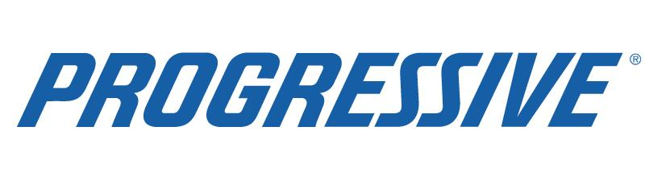






Slide 32
Berlin Summit
November 13-15, 2018
Sponsorship open: Email summit@openstack.org
Early bird open: openstack.org/summit/berlin-2018
Notes:
We have a little bit more time until the Berlin Summit, which will be November 13-15, but sponsorships are open now. If you’re interested you can email summit@openstack.org for more info.

Slide 33
Q&A
openstack
openstack
OpenStackFoundation

