Slide 1
OpenStack Mitaka
Preliminary Marketing Assets
Marketing Community Meeting
March 23, 2016

Slide 2


Slide 3
Agenda
Mitaka release: key themes
User adoption & community updates during Mitaka cycle
Marketing plans & next steps
Background slides & more project details

Slide 4

Notes:
- Datacenter diversity
- Mix of technologies

Slide 5
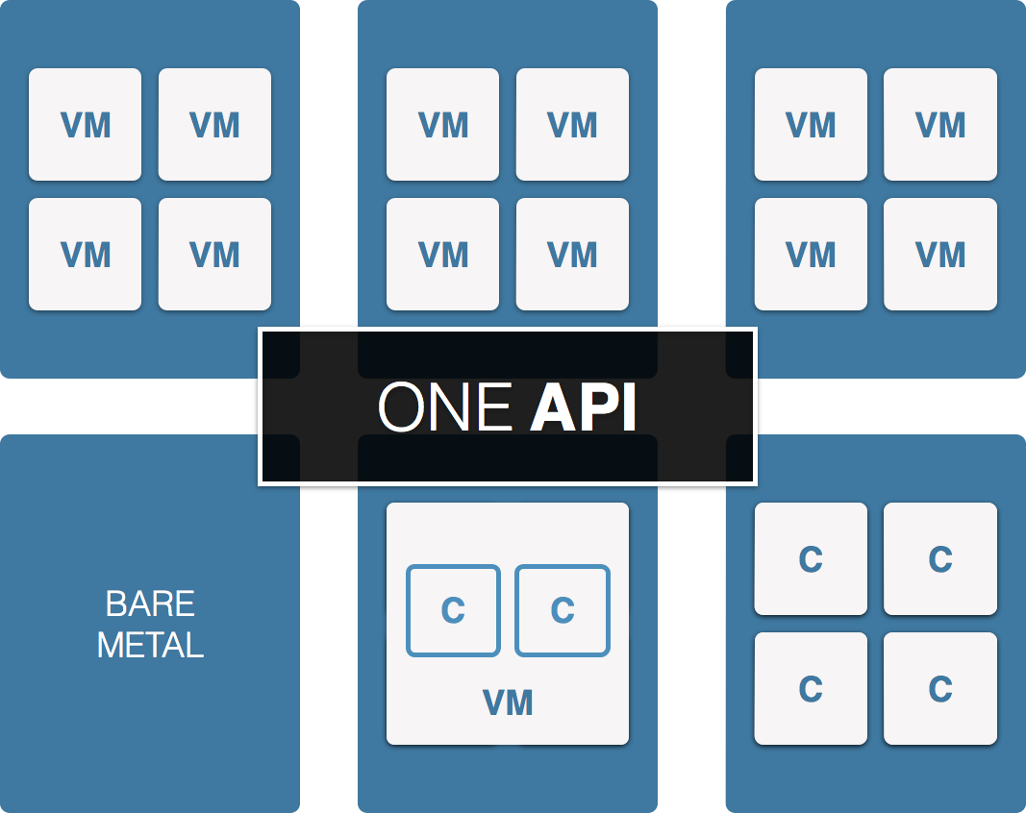

Slide 6
Mitaka release key themes
User Experience
Consistency and better platform for end users
Manageability
Finer grained controls and easier management for operators
Scalability
Performance and stability for larger deployments

Slide 7
Mitaka release key themes
User Experience
OpenStack Client provides single tool to interact with multiple services consistently
Improved SDK support
New simplified Neutron API to “give me a network”
Manageability
Scalability

Slide 8
Mitaka release key themes
User Experience
OpenStack Client provides single tool to interact with multiple services consistently
Improved SDK support
New simplified Neutron API to “give me a network”
Manageability
Simplified configuration for Nova
Easier to setup Keystone; reducing 4 steps to 1
Neutron improved L3 & DVR support
Scalability

Slide 9
Mitaka release key themes
User Experience
OpenStack Client provides single tool to interact with multiple services consistently
Improved SDK support
New simplified Neutron API to “give me a network”
Manageability
Simplified configuration for Nova
Easier to setup Keystone; reducing 4 steps to 1
Neutron improved L3 & DVR support
Heat horizontal scaling; better performance for stateless mode
Designate incremental zone transfers
Keystone fernet tokens
Continued efforts on Cells v2 and scheduler
Scalability

Slide 10














User adoption trends
Enterprise Private Cloud | Public Cloud
Telecom & NFV | Research & Big Data

Slide 11
Community in action
First OpenStack App Hackathon took place in Taiwan with support of Prime Minister
Building strong relationship with telecom community and OPNFV to focus on NFV requirements
New Scientific Working Group created to address very large academic & govt research contingency
First European ops mid-cycle at capacity and extremely productive, working closely with Product Working Group
Continued interest in container orchestration and Ironic bare metal service, as well as containers for deploying OpenStack
Notes:
Security teams growing an merged with vuln team, now at 20+ launching new projects focused on API testing and have a security guide

Slide 12
Mitaka marketing timeline
March 23 – Preliminary marketing assets available
March 31 & April 1st – Press & Analyst Briefings
April 7th –
Mitaka release website is live
Demo video / graphics available
Mitaka release press release issued at 8:01 a.m. Pacific
Mitaka Marketing Assets:
Logo and presentation available: openstack.org/marketing
Mitaka PTL brief video updates: https://www.youtube.com/playlist?list=PLKqaoAnDyfgpMle_oc7rRrjvQ80pDA1jF
Product WG comprehensive roadmap next week

