Slide 1


Slide 2
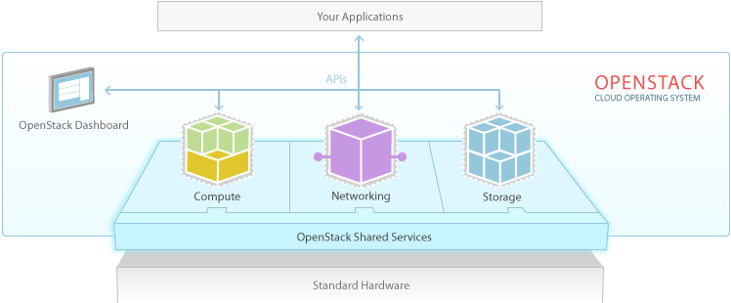
Notes:
Now 11 integrated projects with the addition of Data Processing, most widely-supported cloud platform

Slide 3
  During the Kilo release cycle, the OpenStack community tightly defined a stable set of core services, creating a solid platform for interoperability and to integrate emerging technologies

Slide 4
OpenStack Kilo Key Themes
Stability, scale across core compute, storage and networking services
Defined common foundation for OpenStack clouds
Tightly Defined Core
Rigorous testing standards to ensure consistency across plugin options
Identity federation enables hybrid and multi-cloud use cases
Interoperability
Ironic delivers next generation of bare metal provisioning
Solid platform to support existing workloads, and adopt emerging technologies like containers, PaaS and NFV
Beyond Virtual Machines

Slide 5
Community Continues to Mature
Core services defined by Board and community
  Reached a big milestone defining capabilities and tests for OpenStack core services, to drive interoperability and consistency in downstream market
Common usage patterns emerging
  Companies are deploying OpenStack as the infrastructure standard, or “the line,” within their organization
  Ecosystem expanding around the platform to meet needs of diverse workloads and industries, eg complex networking, big data or new dev oriented tools
Vertically integrated working groups refine use cases
  More product management workflows being built into development processes
  Requirements defined by working groups: Enterprise, Telco, Large deployments, application ecosystem, etc.
Notes:
As core platform matures, focus turns to expanding tested drivers, and extending platform to fit diverse workloads with technologies like bare metal today and containers tomorrow.

Slide 6

Users continue to drive roadmap
A few speaking in Vancouver:
American Express
Time Warner Cable
TD Bank
Symantec
NASA JPL
Cloud & Heat
AVG
Walmart
CERN
Comcast
eBay/PayPal
Adobe
TDBank
Dreamworks
Superuser Award finalist Comcast grew their OpenStack footprint 500% in a year
Read more at superuser.openstack.org

Slide 7
What’s Happening with the Integrated Release?
Integrated Release terminology became too loaded and binary:
  Implied “this is all of OpenStack”, but in reality users would pick & choose components for their clouds
  Conversely, slowing down expansion of integrated release scope meant not supporting innovation around foundational services
Arrival of DefCore created tighter definition and testing of compute, storage and networking services available in OpenStack clouds downstream, a better match to real-world adoption of projects
Upstream community now organizing around tighter core, while opening the door for more innovation under the OpenStack community umbrella

Slide 8
Key Growth Stats
Contributor Growth | 1,494 contributors affiliated with 169 organizations contributed to Kilo (activity.openstack.org)
Total Number of Features | 394 new features in the Kilo integrated release and common libraries (status.openstack.org/release)
Bugs Fixed | 7,257 bugs fixed during the Kilo release cycle (activity.openstack.org)
Top Companies Committing Code | Red Hat, HP, IBM, Mirantis, Rackspace, OpenStack Foundation, Yahoo!, NEC, Huawei and SUSE (activity.openstack.org)
Translations | 792,200 strings translated (transifex.com)
Drivers & Plugins | 113 drivers and plugins supported across the compute, storage and networking capabilities (https://www.openstack.org/marketplace/drivers/)

Slide 9
New Features by Category

Slide 10
Compute
Next generation bare metal provisioning
  First full release of Ironic, providing increased support for managing hardware
  Allows for workloads to be placed in the best environment for their performance requirements
  Already used in production environments like Rackspace OnMetal offerings
New API versioning management
  v2.1 and microversions provide reliable, strongly validated API definitions
  Makes it easier to write long-lived applications against compute functionality
Operational improvements
  Big improvements to live upgrades when a database schema change is required
  Better support for changing the resources of a running VM

Slide 11
Storage
Object Storage
  Initial availability of erasure codes to provide more efficient and cost-effective storage algorithm
  Container-level temporary URLs allow time-limited access to a set of objects in a single container, allowing for easy sharing of specific data
  Improvements to global cluster replication, storage policy metrics, and full Chinese translation
Block Storage
  Major updates to testing and validation requirements for backend storage systems across 70 options
  Ensures consistency across storage options as well as continuous testing of functionality for all included drivers
  Attach a volume to multiple compute instances to enable new high availability and migration use cases

Slide 12
Networking & Shared Services
Networking
Load-balancing as a service API version 2
Additional features to support NFV such as portsecurity for OpenVSwitch, VLAN transparent and MTU API extensions
Architectural updates to improve scale for future releases
Identity
Identity federation that can be enabled across public and private clouds to support hybrid workloads in multi-cloud environments by mapping user accounts to many clouds
Oslo (Common function library)
High Availability improvements through heartbeat monitoring

