Slide 1
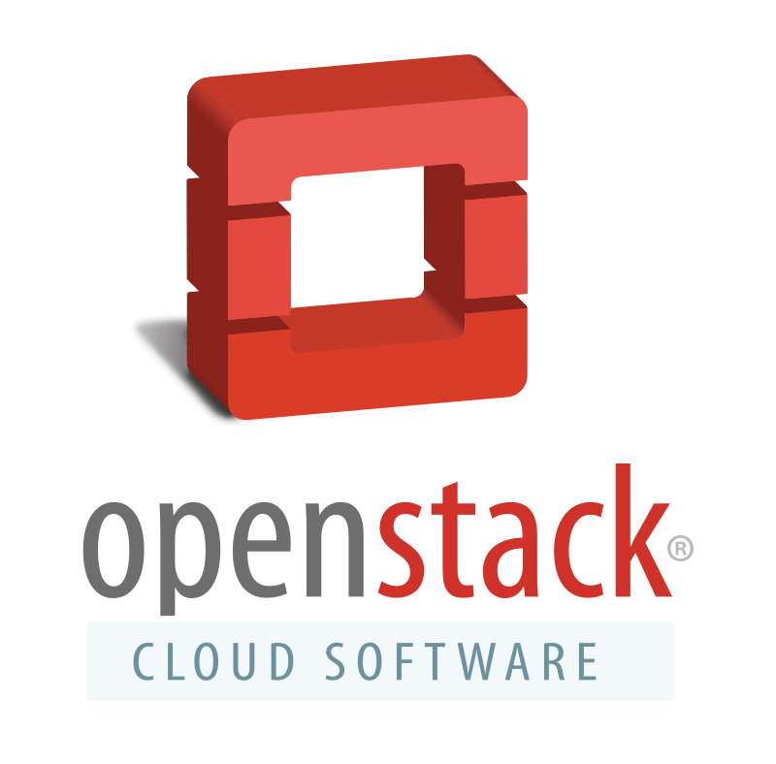
Newton software release
Marketing community preview
September 27, 2016

Slide 2
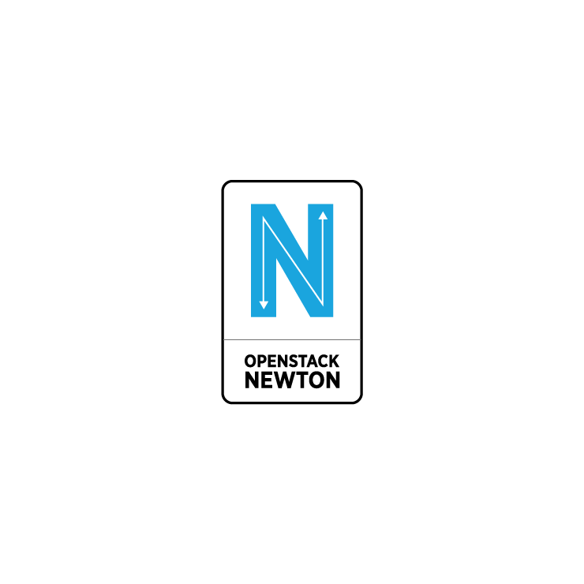
Key release message: One versatile platform
OpenStack is one platform to manage VMs, containers and bare metal
It handles more workloads across more industries, and offers greater range and choice
OpenStack has evolved through Newton to make it easier than ever to manage all of these elements
Notes:
Organizations have to manage a variety of workloads and different technologies. Having a platform that can manage that versatility is extremely valuable.

Slide 3
Key release themes
Provides enterprise-class scale, the ability to scale up or down, cross platforms and geography
High availability and adaptability, self-healing, ensuring stability regardless of workload demands
Enhanced ease of use for operators and app developers, making OpenStack easier to set up, operate, change and fix, with greater automation
Scalability
Resiliency
User experience

Slide 4
Key release themes
Scale up/down with Nova, Horizon, and Swift, Cells V2, Heat convergence by default, multi-tenant Ironic
Availability/ High Availability improved with Cinder, Neutron, Trove and Ironic; Keystone security upgrades (PCI compliance & encrypted credentials)
Nova mutable config settings (reload certain config parameters without restarting the node), get-me-a-network simplifies network configuration, Ease of deployment via Kolla (containerized openstack)
Scalability
Resiliency
User experience

Slide 5

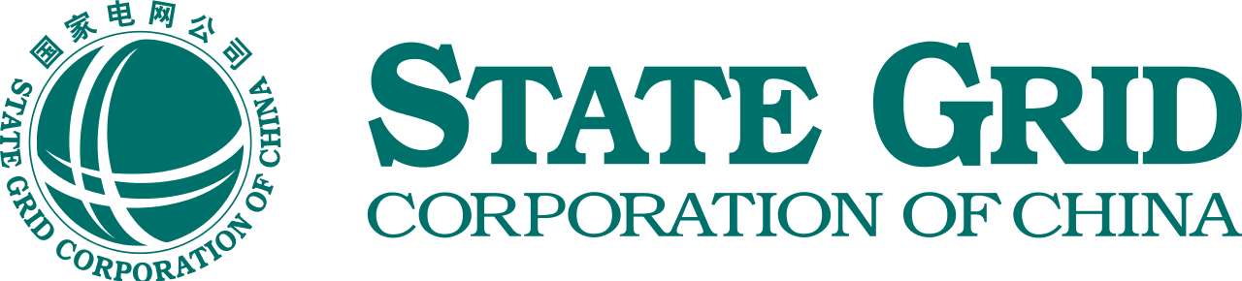
Cost savings, performance & compliance drivers
NEW USERS
JFE Steel Corporation: One of the largest corporations in Japan, JFE Steel produces 30 million tons of crude steel per year, making it the second producer in Japan and ninth in production worldwide. They improved CPU utilization 30-70% and expect to realize a 28% reduction in overall IT costs.
State Grid Corporation: The State Grid Corporation of China (SGCC) is the world’s largest electric utility company and the seventh largest company in the world. The State Grid has rolled out OpenStack in nine datacenters and continues to expand.

Slide 6
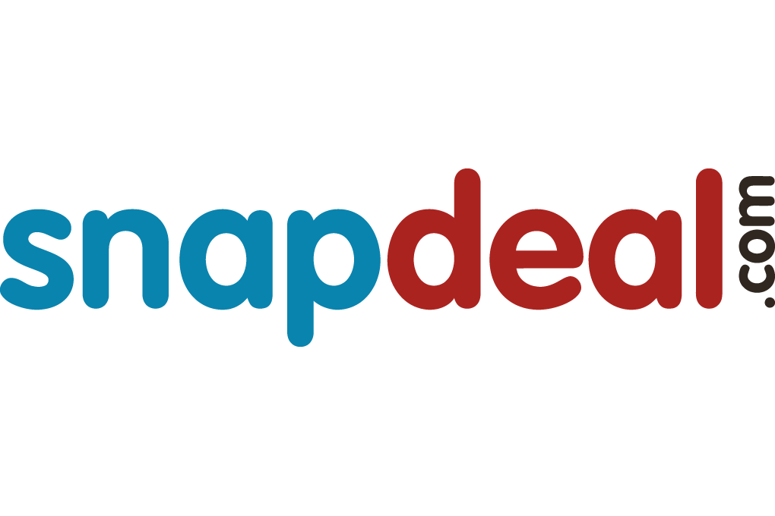
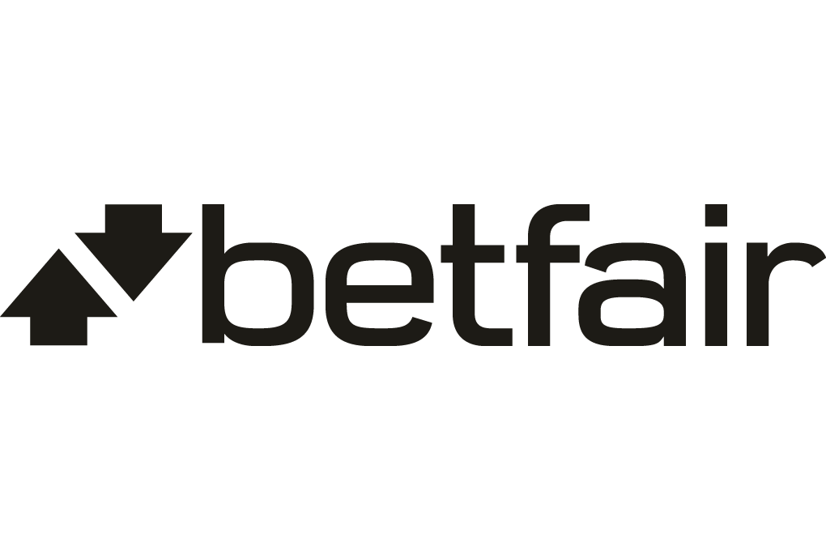
Cost savings, performance & compliance drivers
NEW USERS
Snapdeal: India’s largest online marketplace, Snapdeal just launched a 100,000-core OpenStack deployment to achieve cost savings and exponential performance gains across its applications.
Betfair: The popular sports betting site in Europe with 120 million transactions per day, Betfair uses Openstack for its CI/CD pipeline and to support more than 200 applications to production.
Many more case studies at superuser.openstack.org

Slide 7
Newton Cycle Trends & Updates
OpenStack awarded Core Infrastructure Initiative (CII) badge, signaling the community’s commitment to security-conscious development practices. Read more about the OpenStack Security Team in the latest brief:
www.openstack.org/software/security
The DefCore Working Group has been renamed to the Interop Working Group to reflect their strategic mission. The Board voted on a new testing spec in August that will raise the bar for workload portability and user experience, adding over 100 new tested capabilities to the interop guideline.

Slide 8
Newton Cycle Trends & Updates
The number of OpenStack public cloud providers has grown to more than 30 worldwide, and established providers like Internap and City Network are expanding their businesses into new regions.
China has been a fast growing market for OpenStack with major financial services, manufacturing and telecom users including China UnionPay, DongFeng Motors, China Telecom, China Mobile, Lenovo, Hengfeng Bank, Post Savings Bank of China and the State Grid of China. There is also a strong startup community, including two Chinese Gold Members EasyStack and UnitedStack.

Slide 9
Spotlight: Containers & Bare Metal
IRONIC
MAGNUM
KURYR
Bare metal provisioning
Multi-tenant Networking
Tighter integration with Magnum & Kubernetes
Operations
Better integration with Nova
Kolla now supports deploying to Ironic
Provisioning for container orchestration tools Swarm, Kubernetes, Mesos
Created operator-centric Magnum Install Guide
Support for pluggable drivers
Ironic support for Kubernetes cluster
Asynchronous cluster creation
Bringing Neutron networking capabilities to containers
First release for Swarm integration
First release for Kubernetes integration
Nested VMs through integration with Magnum and Neutron (early release)

Slide 10
Final thoughts
OpenStack is proving its responsiveness to user needs by tackling some of the biggest issues with Newton’s new features and enhancements.
OpenStack is the integration engine that brings together a host of new technologies, including Mesos, Kubernetes, and more.
All eyes are on the users, continuously improving the user experience.
Newton is OpenStack’s 14th software release
Notes:
Integration engine - bring it all together (Mesos, Kubernetes, etc.)

Slide 11
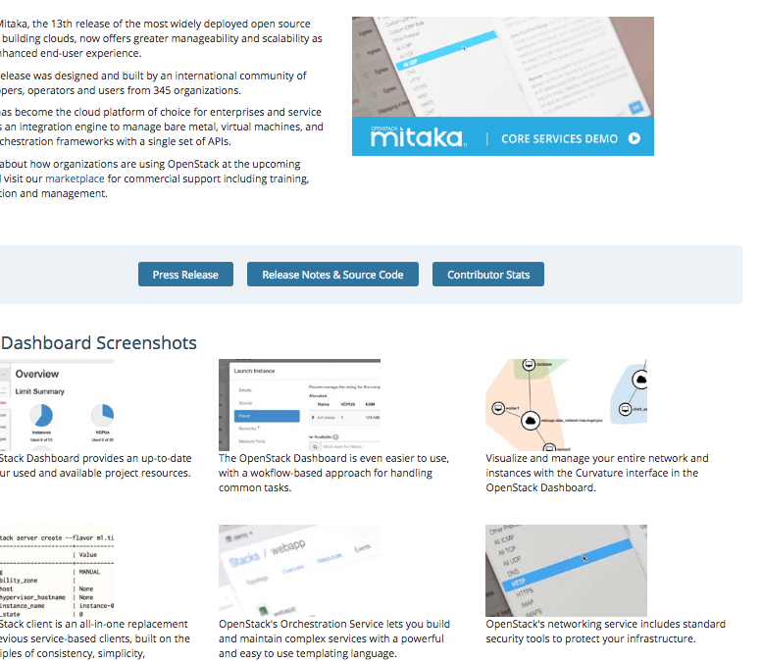
Newton release plans
Release date: Thursday, Oct. 6
This marketing preview is recorded & will be posted publicly. In the Mitaka cycle, this presentation video got 2,500 views.
Press release and release website in progress: http://www.openstack.org/software/newton/
Video demo in progress highlighting these
key features.
Like Mitaka, Newton will feature a video demo.

Slide 12
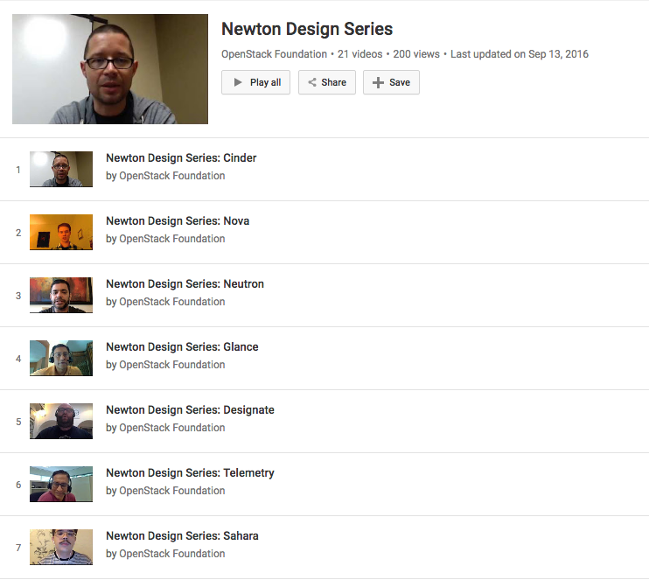
Want to know more about individual features?
Check out the Newton Design Series, 5-minute interviews with more than 20 PTLs about user needs, key features and enhancements.
YouTube playlist:
http://tinyurl.com/OpenStack-N

Slide 13
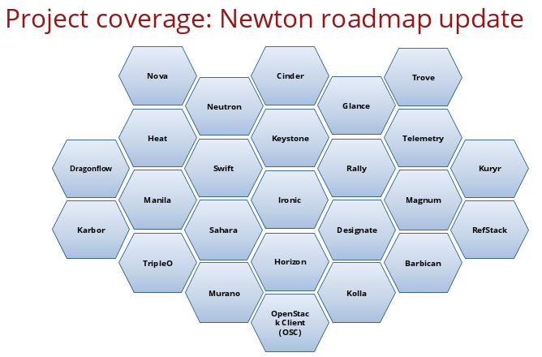
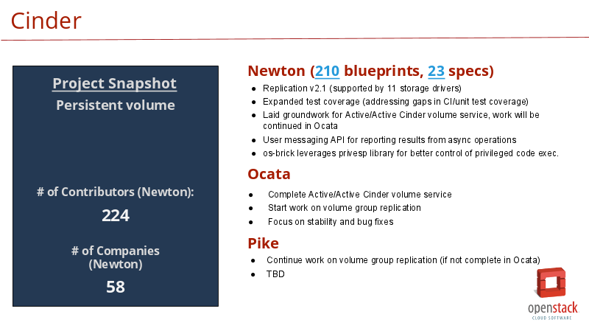
Beyond Newton: the community-generated roadmap
Created by the Product Work Group’s roadmap team, led by Shamail Tahir
Input from PTLs at two points in the cycle—generates top features/ enhancements for the next release
Looks forward 3 cycles, identifying development “themes”
openstack.org/software/roadmap
Roadmap 100-foot view example.
Notes:
Roadmap: https://drive.google.com/open?id=0B_yCSDGnhIbzZUNSaWZYdDQ2Wms

