Slide 1
OpenStack Liberty
October 15, 2015

Slide 2


Slide 3
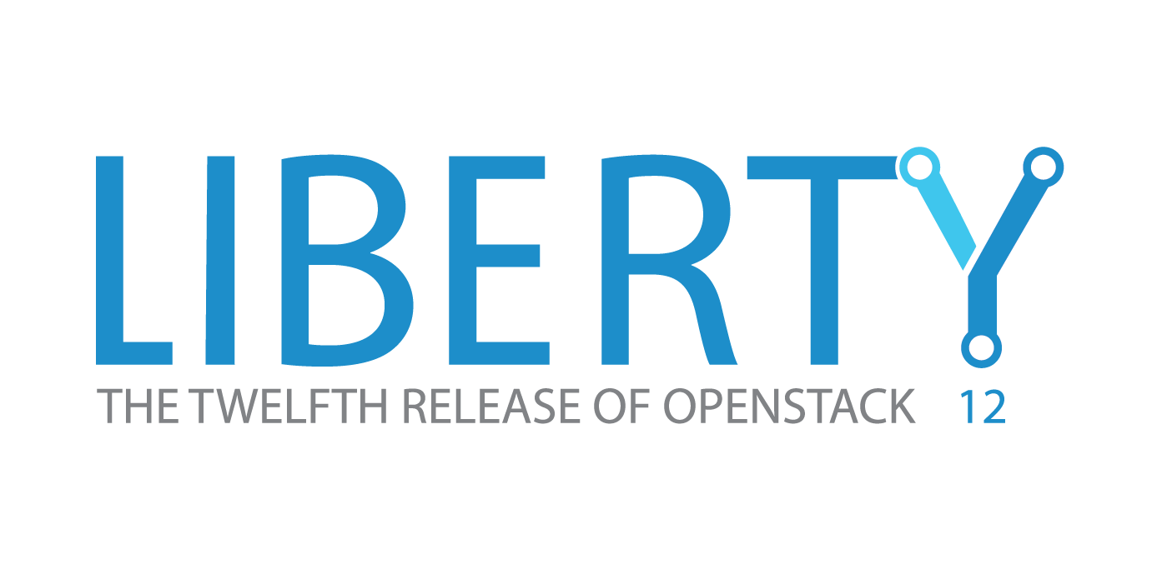

Slide 4
Agenda
Core + optional services in the “Big Tent”
Liberty release: key themes
Community updates during Liberty cycle
Background slides & more project details

Slide 5
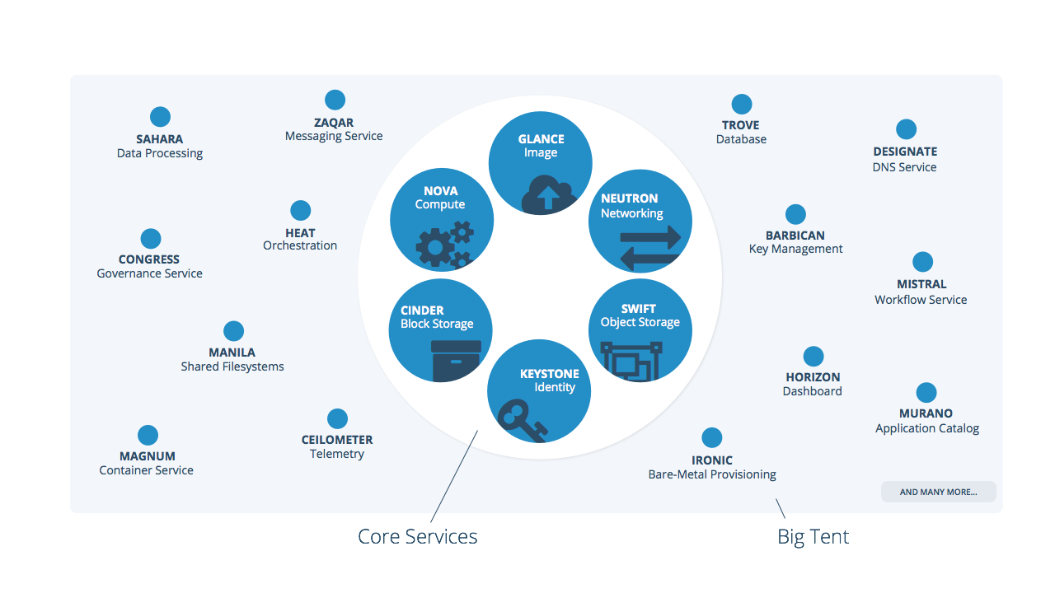
The “big tent” and “core services”
[1] Full list of “big tent” services : http://governance.openstack.org/reference/tags/type_service.html#tag-type-service

Slide 6
Liberty release key themes
Manageability
Finer grained controls and easier management for operators
Scalability
Performance and stability for larger deployments
Extensibility
Single platform for virtual machines, containers and bare metal
Notes:
Manageability: Improvements to the user experience and operational ease-of-use
Scalability: Increasing the scale at which the service can operate
Extensibility/ Integration: Expanding the service architecture beyond an interoperable core, integrating new functions to continue to innovate on a single platform
Enabling operations across multiple OpenStack clouds (federation), or promoting a common experience when the service is deployed in separate OpenStack-Powered clouds (interop) [strong support for emerging technology trends (mesos support in magnum, more bare metal functionality; leading container networking capabilities through magnum, kuryr and neutron, making these technologies more accessible sooner than ever before)]
Theme 1: Scalability
Theme 2: Resiliency
Theme 3: Manageability
Theme 4: Modularity
Theme 5: Interoperability
Manageability: Improvements to the User Experience and operational ease-of-use
Modularity: Dividing the service architecture into services that are more manageable, or have a smaller service or code base
Interoperability: Enabling operations across multiple OpenStack clouds (federation), or promoting a common experience when the service is deployed in separate OpenStack-Powered clouds (interop)

Slide 7
Liberty release key themes
Manageability
Common library adoption
Better configuration management
Role-based access control (RBAC) for Heat and Neutron fine tune security settings at all levels of network and API
Initial version of Nova Cells v2 provides an updated model to support very large and multi-location compute deployments
Improvements in scale and performance across Nova, Horizon, Neutron and Cinder
Scalability
Stronger support for OpenStack as the integration engine with new big tent model
Magnum’s first full release supports Kubernetes, Mesos and Docker Swarm
Extensible Nova scheduler
NFV improvements for QoS policies, LBaaS
Extensibility
Notes:
Manageability: Improvements to the user experience and operational ease-of-use
Scalability: Increasing the scale at which the service can operate
Extensibility/ Integration: Expanding the service architecture beyond an interoperable core, integrating new functions to continue to innovate on a single platform
Enabling operations across multiple OpenStack clouds (federation), or promoting a common experience when the service is deployed in separate OpenStack-Powered clouds (interop) [strong support for emerging technology trends (mesos support in magnum, more bare metal functionality; leading container networking capabilities through magnum, kuryr and neutron, making these technologies more accessible sooner than ever before)]
Theme 1: Scalability
Theme 2: Resiliency
Theme 3: Manageability
Theme 4: Modularity
Theme 5: Interoperability
Manageability: Improvements to the User Experience and operational ease-of-use
Modularity: Dividing the service architecture into services that are more manageable, or have a smaller service or code base
Interoperability: Enabling operations across multiple OpenStack clouds (federation), or promoting a common experience when the service is deployed in separate OpenStack-Powered clouds (interop)

Slide 8
Community in action
Security team gaining momentum & launching new projects including Anchor and Bandit
Product working group adding more cohesion across projects and maturity to the roadmap and planning processes through Mitaka and the N release
Continued work around interoperability with DefCore committee adding Neutron networking capabilities to tightly defined core services
Notes:
Security teams growing an merged with vuln team, now at 20+ launching new projects focused on API testing and have a security guide

Slide 9
Adoption continues across industries & regions
Featured speakers at the Tokyo Summit:
GoDaddy, NTT, Fujitsu, FICO, Lithium, BMW, Visa, Ancestry.com, GMO, Yahoo! Japan (and Yahoo!), Workday, CERN, eBay, Comcast, Time Warner Cable, PayPal, DirecTV, Tubemogul, DeutscheTelekom, SKT, Kirin

Slide 10
The Nitty Gritty
Background slides & more project details

Slide 11
Compute (Nova, Ironic): New features
Cells v2 is a next-generation Nova tool to manage very large deployments
  Cells v2 will be extended with additional features in Mitaka and beyond
Continued improvements in Nova upgrade support, with a special focus on improving database upgrade performance
Improved Nova scheduler interface makes it easier to write and customize scheduling algorithms
New bare metal drivers and improvements to the existing drivers

Slide 12
Storage (Cinder, Swift): New features
Swift performance enhancements for building and expanding object storage clusters
  Also: Improvements to the new Erasure Code feature, and a new bulk upload capability for API end users
Cinder now allows multiple cinder services to run simultaneously, connected to a single back end, enabling a more highly available configuration of the block storage service
Non-disruptive backups for Cinder are now allowed at volume, without detaching from a machine

Slide 13
Networking (Neutron): New features
RBAC for networking allows more granular security for end-user tenants on Neutron networks
  Provides separation between tenants on the same network resources
Pluggable IP Address Management (IPAM) created a hook into Neutron for various IPAM providers and services
  Many large networks already have a system for this and need to integrate their clouds with it
Improved support for NFV requirements, LBaaS, and new Quality of Service (QoS) APIs for limiting bandwidth and creating policies per network and per port
  Quality of Service APIs will be expanded in future releases

Slide 14
Strong support for containers continues
First full release of Magnum project, making containers first class components in an OpenStack cloud
  Supports leading container management tools including Docker, Kubernetes and Mesos
Magnum makes it easier to adopt container technology by tying into existing OpenStack services such as Nova, Ironic and Neutron
  Further improvements are planned with new project, Kuryr, tying into native container networking such as Libnetwork API
Kolla project easily deploys a containerized OpenStack environment up to 100 nodes

Slide 15
Heat orchestration: New features
Heat includes dozens of new resources for management, automation and orchestration of the expanded capabilities of the “big tent”
Big improvements for management and scale, including APIs to expose what resources and actions are available, all filtered by RBAC
New convergence engine is enabling more complex actions with more resilience.
  This engine debuts in Liberty and will be more fully functioning in Mitaka and beyond.

Slide 16


